Slide 1


SW113
Lecture 4
Instructor:
Nusrat jahan
Lecturer, SWE, DIU.

Slide 2
What is “Agility”?
Effective (rapid and adaptive) response to change
Effective communication among all stakeholders
Drawing the customer onto the team
Organizing a team so that it is in control of the work performed
Yielding …
Rapid, incremental delivery of software

Slide 3
An Agile Process
Is driven by customer descriptions of what is required (scenarios)
Recognizes that plans are short-lived
Develops software iteratively with a heavy emphasis on construction activities
Delivers multiple ‘software increments’
Adapts as changes occur

Slide 4
Agility Principles - I
1. Our highest priority is to satisfy the customer through early and continuous delivery of valuable software.
2. Welcome changing requirements, even late in development. Agile processes harness change for the customer's competitive advantage.
3. Deliver working software frequently, from a couple of weeks to a couple of months, with a preference to the shorter timescale.
4. Business people and developers must work together daily throughout the project.
5. Build projects around motivated individuals. Give them the environment and support they need, and trust them to get the job done.
6. The most efficient and effective method of conveying information to and within a development team is face–to–face conversation.

Slide 5
Agility Principles - II
7. Working software is the primary measure of progress.
8. Agile processes promote sustainable development. The sponsors, developers, and users should be able to maintain a constant pace indefinitely.
9. Continuous attention to technical excellence and good design enhances agility.
10. Simplicity – the art of maximizing the amount of work not done – is essential.
11. The best architectures, requirements, and designs emerge from self–organizing teams.
12. At regular intervals, the team reflects on how to become more effective, then tunes and adjusts its behavior accordingly.

Slide 6
Existing Agile Methods
Extreme Programming
Scrum
Crystal Methods
Feature Driven Development
Lean Development
Dynamic Systems Development Methodology (DSDM)

Slide 7
Extreme Programming (XP)
The most widely used agile process, originally proposed by Kent Beck
XP Planning
Begins with the creation of “user stories”
Agile team assesses each story and assigns a cost
Stories are grouped to for a deliverable increment
A commitment is made on delivery date
After the first increment “project velocity” is used to help define subsequent delivery dates for other increments

Slide 8
Extreme Programming (XP)
XP Design
Follows the KIS principle
Encourage the use of CRC cards (see Chapter 8)
For difficult design problems, suggests the creation of “spike solutions”—a design prototype
Encourages “refactoring”—an iterative refinement of the internal program design
XP Coding
Recommends the construction of a unit test for a store before coding commences
Encourages “pair programming”
XP Testing
All unit tests are executed daily
“Acceptance tests” are defined by the customer and excuted to assess customer visible functionality

Slide 9
Extreme Programming (XP)

Slide 10
Scrum
Originally proposed by Schwaber and Beedle
Scrum—distinguishing features
Development work is partitioned into “packets”
Testing and documentation are on-going as the product is constructed
Work occurs in “sprints” and is derived from a “backlog” of existing requirements
Meetings are very short and sometimes conducted without chairs
“demos” are delivered to the customer with the time-box allocated

Slide 11
Scrum

Slide 12
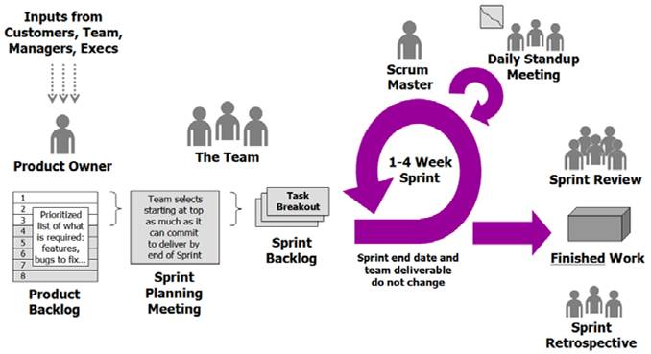
Functionality of Scrum

Slide 13
Thanks

